Slide 1
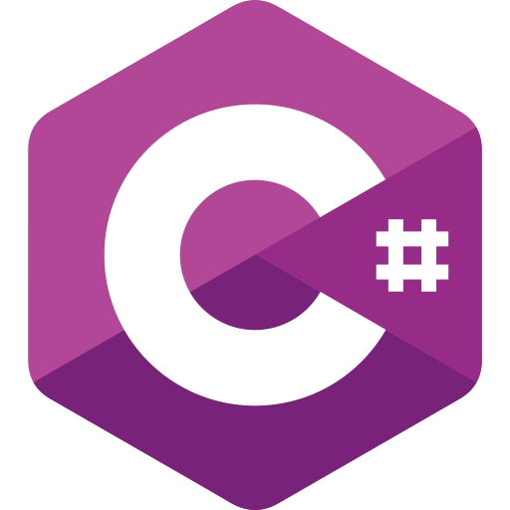


Day 1
Introducing of dot net
Installation
Create New Project
Learn Dot Net
By : Rian Rudianto

Slide 2
Note
Before starting this lesson, make sure you have studied the concepts of API and C# programming language.
Learn Dot Net
By : Rian Rudianto

Slide 3
What is dot net?
Dot net or .NET is a software development platform by Microsoft used to build various types of applications, including web, desktop, mobile, and cloud apps. It supports multiple programming languages like C#, F#, and VB.NET, and provides libraries and tools to streamline the development process.
Learn Dot Net
By : Rian Rudianto

Slide 4
Installation
You need to install the .NET SDK and Visual Studio or Jetbrains Rider as the IDE.
.Net SDK : Download .NET (Linux, macOS, and Windows) | .NET
Check dot net version using terminal use command dotnet --version
Visual Studio : Visual Studio: IDE and Code Editor for Software Development
Jetbrains Rider : Download Rider: The Cross-Platform .NET IDE
Learn Dot Net
By : Rian Rudianto

Slide 5
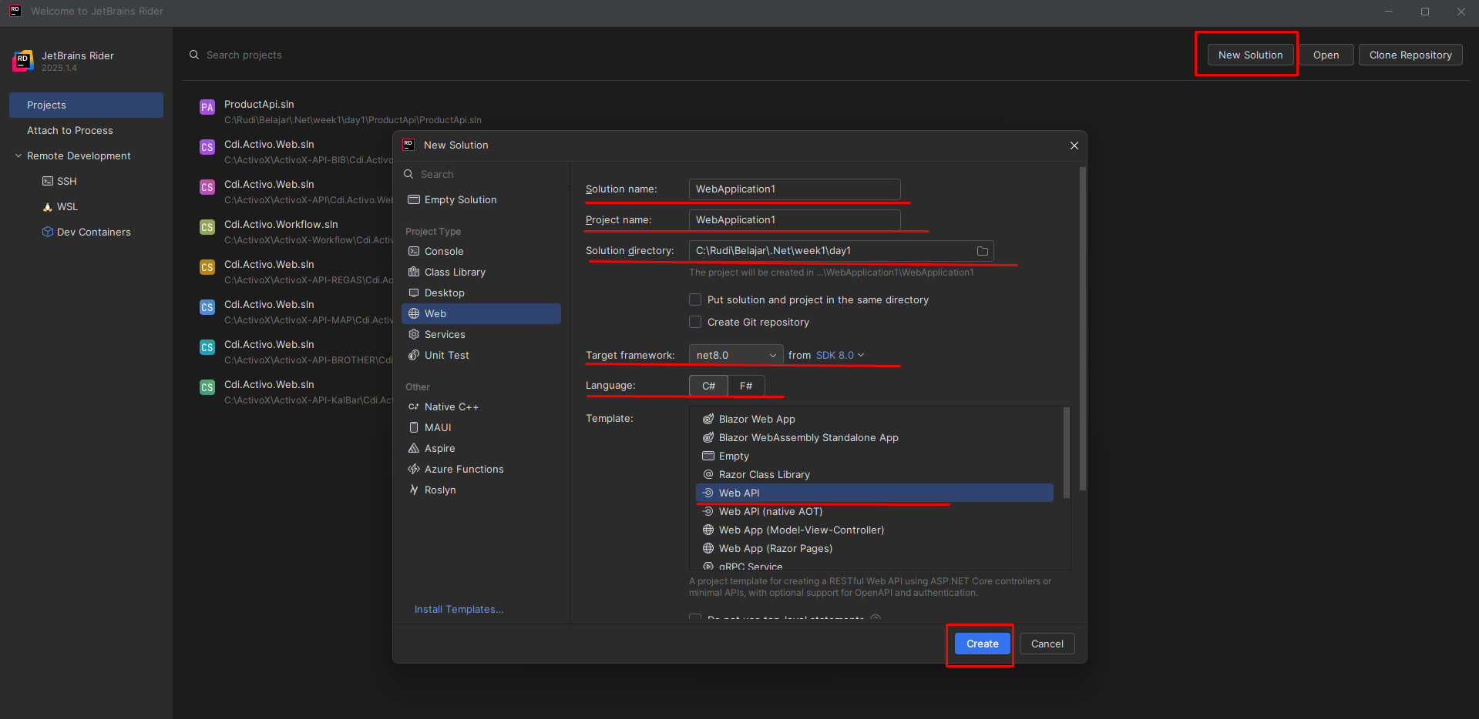
Create New Project
You can use visual studio to create a new project
Create directory for your project
Open Rider
New Solution
Fill in project name and solution name
Choose directory
Choose target framework (using Lts, now net 8)
Choose language (C#)
Choose template (Web API)
Learn Dot Net
By : Rian Rudianto

Slide 6
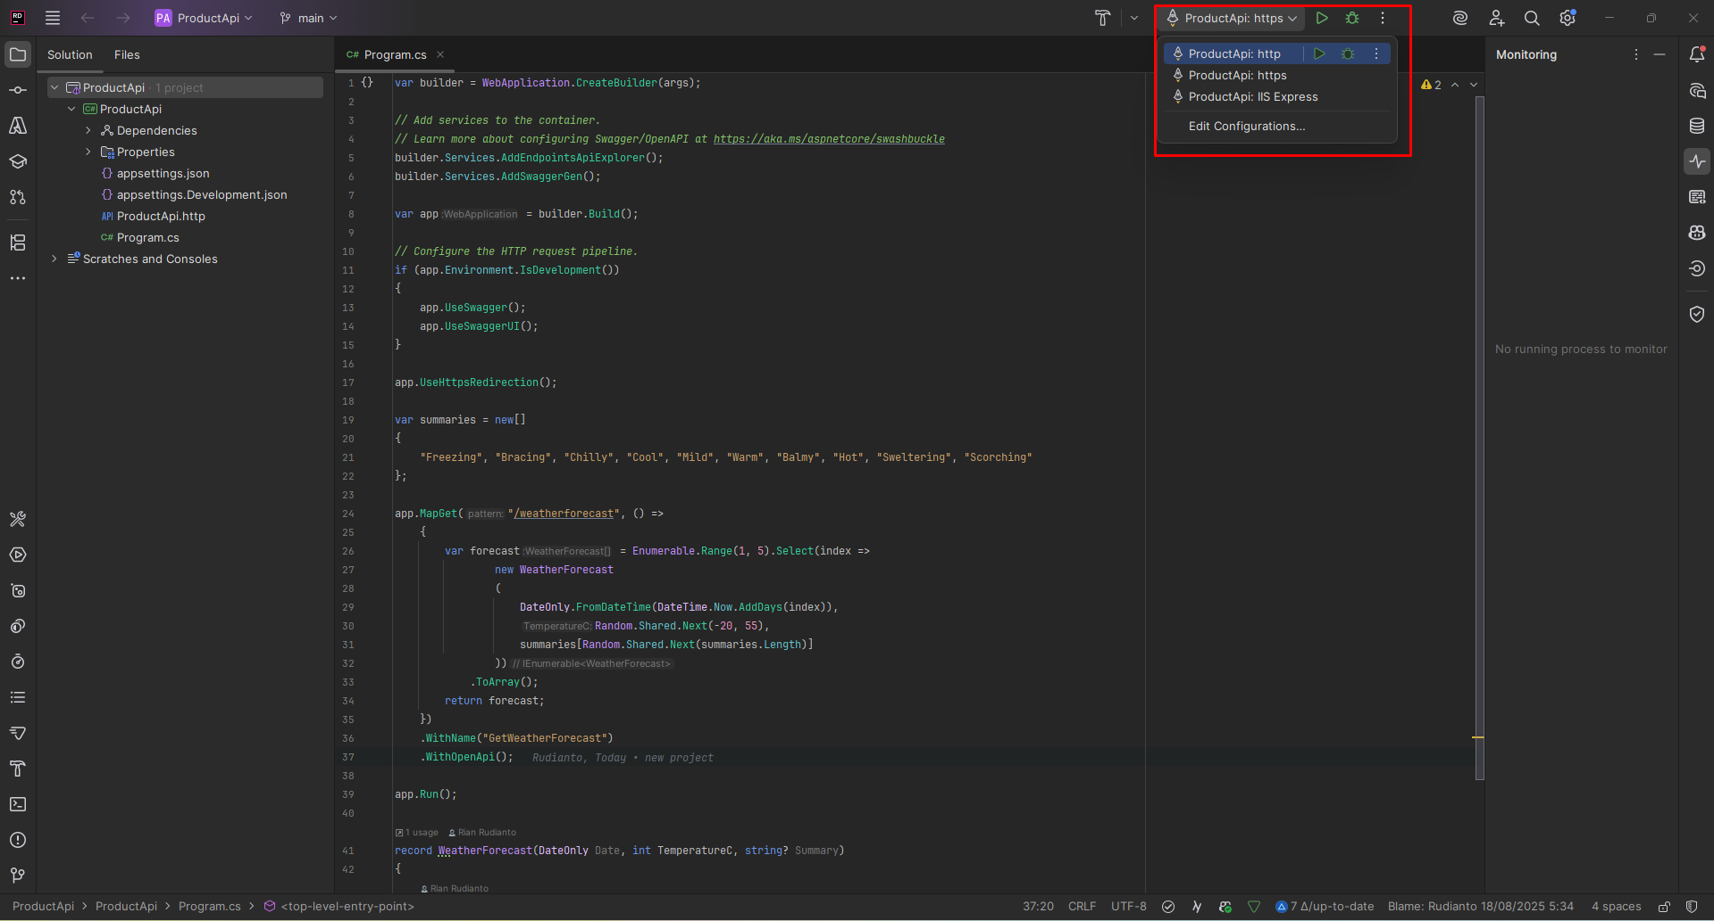
Run the app
To run the app you can choose to use http, https or IIS express
Learn Dot Net
By : Rian Rudianto

Slide 7
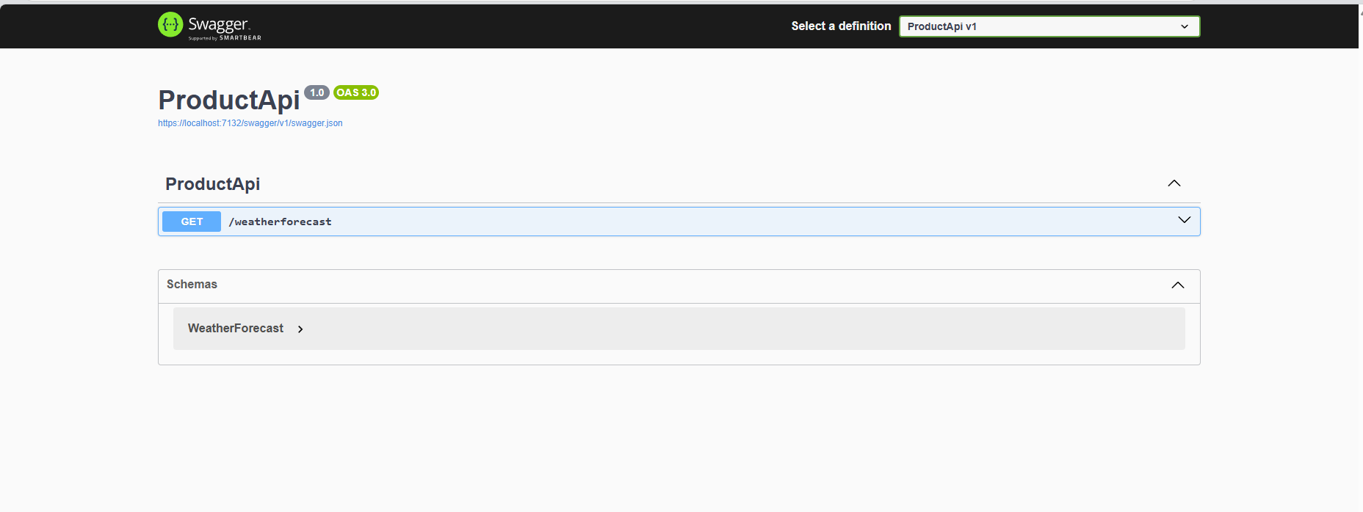
Result Swagger UI
Learn Dot Net
By : Rian Rudianto

